Slide 1

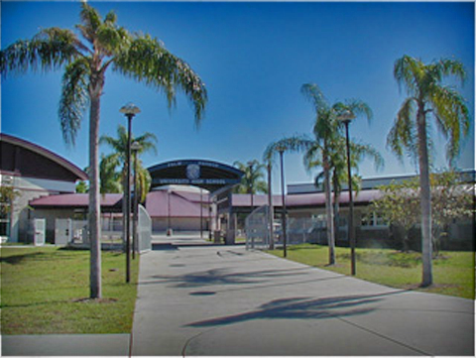
Sophomore Seminar
Class of 2027

Slide 2


Graduation Requirements
University Requirements
Xello
Credit Recovery
Tutoring
PSAT
Early College
Dual Enrollment
Bright Futures
Padlet
This Photo by Unknown Author is licensed under CC BY-SA

Slide 3
Meet your Counselors
University A-G: Elizabeth Ryczek
University H-O: Tim Papp
University P-Z: Amanda Madej
Medical: Erika Picard
College and Career Readiness Coordinator: Sarah Lopez

Slide 4


Graduation Requirements
24 credits
Must meet all subject level credit requirements!
GPA
Minimum 2.0 unweighted
Testing
Must PASS Grade 10 FAST ELA
OR
Earn a concordant score on SAT (480 EBRW), ACT (avg 18 Read & Eng) or CLT (sum 36 Verbal Reasoning/Grammar)
Must PASS Alg 1 EOC
OR
Earn a concordant on PSAT (430-math), SAT (420-math), ACT (16-math), or CLT (11-quantitative)
This Photo by Unknown Author is licensed under CC BY-NC-ND

Slide 5
Graduation Requirements
English (4.0 credits)
Math (4.0 credits) - Including Algebra 1 and Geometry
Science (3.0) credits- Including Biology
Social Studies (3.0 credits)- World History, US Govt, Econ, US History
Fine/Performing Art or CTE
(1.0 credit)
Health/PE
(HOPE 1.0 credit)
Personal Financial Literacy (0.5 credit)

Slide 6
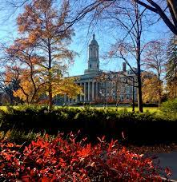
4 Year College/University Requirements
In addition to HS Grad Requirements, you must take:
Algebra 2
2 or 3 years of foreign language (consecutive, same language)
Recommendation:
take foreign language throughout HS
take advanced coursework (AP, DE, Honors)
take additional math and science courses (as advanced as you can)

Slide 7
Post Secondary Options
What are your choices?
4 year college/university
2 year college
Tech/Trade school
Military—test required
Right to work

Slide 8





Slide 9
10th Grade Xello Tasks
Xello can be accessed through Clever, you will complete mandatory lessons each semester:
Semester 1- Program Prospects
Semester 2 – Careers and Lifestyle Costs

Slide 10
Credit Recovery/Grade Forgiveness
You MUST recover graduation requirement classes if you receive an F
You SHOULD recover graduation requirement classes if you receive a D
How?
  After school credit recovery (ELP)
When?
  Mondays through Thursdays from 2:00-4:00pm
Where?
  PHUHS room 19-207
  English-Mon & Wed
  Math- Tues & Thurs
  Science- Mon & Wed
  Social Studies- Mon, Tues, Wed, Thurs
  Students typically finish a course in about 22 hrs. Varies student to student.
SEE COUNSELOR TO SIGN UP!

Slide 11

Tutoring Resources
Many tutoring opportunities at school and at home!
After School Homework Help @ PHUHS
MATH: Tuesdays 2:05-4:05 in room 19-131
ENGLISH: By appointment (contact Ms. Rackl)
US HIST: Tuesdays 2:05- in room 19-224
Other subjects by teacher by appointment (contact your teacher directly)
Homework Helpline Available Monday-Thursday // from 5pm-8pm // 727-547-7223
This Photo by Unknown Author is licensed under CC BY-ND

Slide 12

Homework/Studying
Doing your homework and studying are essential!
Tips
  create a study plan (quiet place, time of day, how long?)
  manage your time
  get in a routine
  ask for help! (HW helpline, parents, khan academy, etc.)

Slide 13
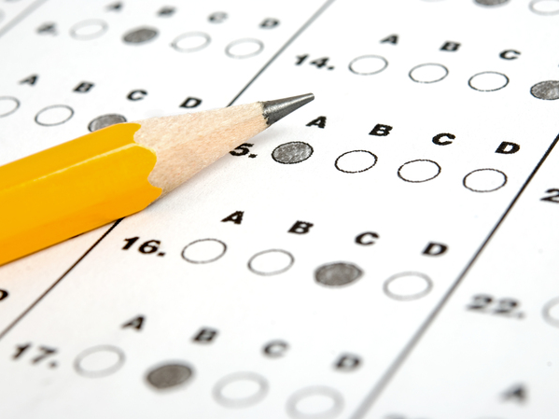
PSAT
All 10th graders will take PSAT
October 8th -Room assignments posted cafeteria in few weeks
Additional Resources:
  www.SATpractice.org
  www.collegeboard.org
This Photo by Unknown Author is licensed under CC BY-ND

Slide 14
PSAT: Benefits
Prepares you for the SAT (preliminary SAT)
Can be used to satisfy Alg 1 EOC requirement (if meet concordance)
Provides your personalized strengths and areas that need improvement- link to www.satpractice.org for personalized SAT prep
Important to take next year as a Junior
  To qualify for National Merit Scholarship
  To qualify for additional scholarships:
    Telluride Association
    National Hispanic Recognition Award
    National Scholarship Service

Slide 15
Dual Enrollment/Early College
Sophomore year is crucial for DE/EC admissions for junior year
Qualifications:
  3.0 unweighted GPA (by deadline for paperwork)
  qualifying PERT scores or ACT/SAT/PSAT
  SPC ID number

Slide 16

Early College
Early College Program
Program at SPC (Saint Petersburg College)
Can complete 2 years of college and earn associate’s degree by HS graduation
All courses will be on SPC campus
Will have college counselor assigned at SPC
Must meet qualifications and be chosen from lottery (3.0 unweighted GPA, qualifying PERT/ACT/SAT/PSAT scores, coursework)
Must complete HOPE, World Hist, Geo, Pers Fin Lit prior to starting ECP
What should I do now?
Go to spcollege.edu and enroll as a student (select for high school program) to get SPC ID #
Bring SPC ID # to counselor and see if have qualifying test scores
  If not, sign up to take PERT at SPC
Attend information session in November/December
Complete and turn in application before early February deadline or January Priority deadline

Slide 17
Dual Enrollment
Taking college courses either here on campus or at SPC's campus
PHUHS offers 3 DE courses on our campus-Composition I/II; Int Alg/College Alg; College Experience
All other courses need to be taken at SPC- need transportation
Requirements- 3.0 unweighted GPA, qualifying PERT/ACT/SAT/PSAT scores
Registration through counselor; deadlines are always semester before the class begins
Stay updated on deadlines w/ padlet, school website, asking counselor

Slide 18
PERT
College qualifying exam
Obtain SPC ID #, bring to counselor, fill out PERT form, take PERT
SPC will email your preferred email address for PERT test scheduling
  Can only take PERT twice a semester
  Important to study, especially if do not receive qualifying score first time
  Resources: https://www.spcollege.edu/future-students/admissions/testing
    or google PERT practice

Slide 19

Dual Enrollment
Pinellas Technical College dual enrollment program
Qualifications: 2.0 GPA; good attendance and behavior
Periods 1-3
Can earn certificate in program for free; can earn college credits to transfer
CLEARWATER CAMPUS PROGRAMS:
Automotive service technology
Barbering
Cabinetmaking
Computer systems and IT
Diesel systems tech
Electricity
Electronic Systems Integration & Automation
Machining tech
Medical administrative specialist
Network support services
Practical Nursing
Professional culinary arts and hospitality
Web development

Slide 20

3 levels
All require:
  Volunteer or paid work hours (different amount for each)
  4 credits English
  4 credits Math (Alg 1 and higher) –if you are in Alg 1 now will need additional credit
  3 credits Science
  3 credits Social Studies
  2 credits World Language (sequential, same language!)
  SAT/ACT scores

Slide 21
Bright Futures, how do I volunteer?
1. Students determine where they want to complete their service/work and complete a Bright Futures Service/Work Hours Proposal form (PCS form 2-2602-2).
2. Turn in the proposal to your counselor for review and to determine if it is acceptable.
3. If acceptable, complete the Bright Futures Log & Reflection form (PCS form 2-2602-3) to track hours. This is turned in at the high school upon completion.
4. Students must complete and have an approved proposal for each location and maintain separate log forms.

Slide 22
Communication
Stay up to date on important announcements and upcoming events
  School website: www.pcsb.org/phuhs
  Weekly update emails (goes to parents)
  University student Padlet: https://padlet.com/madeja/university-student-padlet-wci6imj5weyvz2pv

Slide 23
